Slide 1
DEXPI File Comparison for Test Automation
2023-10-09
Matching
Evaluation

Slide 2
Matching Problem
ConceptualModel
ConceptualModel
TaggedPlantItems
TaggedPlantItems
PlateHeatExchanger
CentrifugalPump
?
CentrifugalPump
CentrifugalPump
PlateHeatExchanger
PipingNetworkSystems
PipingNetworkSystems
PipingNetworkSystem
PipingNetworkSystem
?
PipingNetworkSystem
PipingNetworkSystem
PipingNetworkSystem
reference
variant

Slide 3
Matching Solution
variant
scores for all possible pairs; based on, e.g.,
persistent identifier (very high weight)
other identifiers (tag name, object display name, …)
object type
topology
…
PlateHeatExchanger
CentrifugalPump
CentrifugalPump
…
…
CentrifugalPump
…
…
for sub-tagged motors
PlateHeatExchanger
…
…
reference
Driver/Motor
0..1
numerical optimization, maximize overall score
variant
PlateHeatExchanger
CentrifugalPump
matching pairs
- in general, there is no unique correct matching
- for NOAKA blueprints:
if variant is correct, the unique correct matching is found (WIP…)
CentrifugalPump
CentrifugalPump
PlateHeatExchanger
reference

Slide 4
Evaluation
pnb PID Toolbox 1.2 alpha 3:
- correct type (classes/aggregated data types) 5 points
- correct data values (daty types except aggregated) 1 point
- correct object reference 1 point
- superfluous value -1 point
planned:
- each ERROR from verificator -1 point
percentage in range -∞ to 100 %

Slide 5
Miscellaneous
pnb PID Toolbox 1.2 alpha 3:
- only ConceptualModel + symbol registration numbers
planned:
- some more graphics checks
- ignore PipingNetworkSegments ignored i.e., matching of their children is done on the level of PipingNetworkSystems
- some superfluous values may be acceptable
e.g., tools-specific persistent identifiers

Slide 6
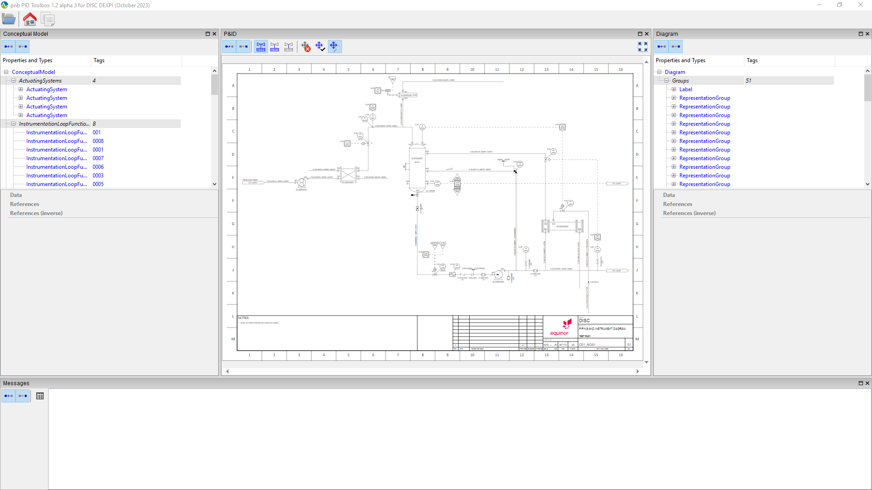
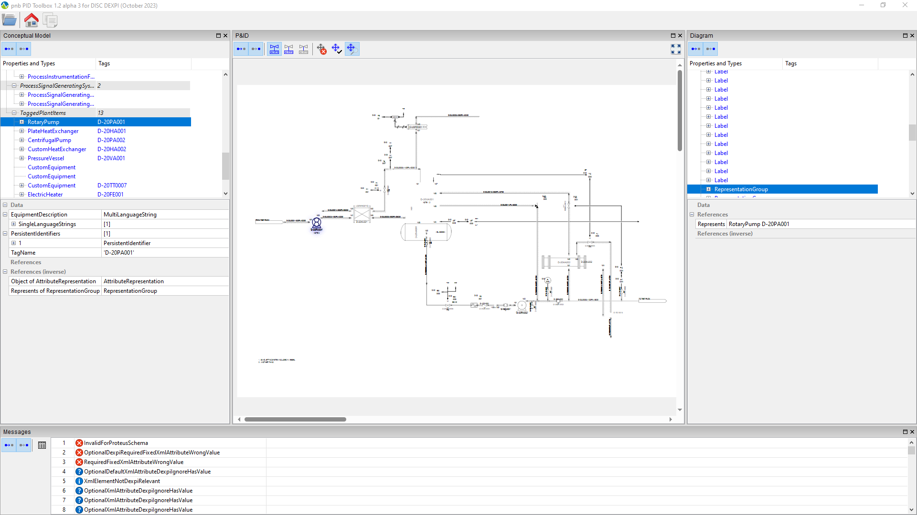
Example
reference (DISC_EXAMPLE-04-01.xml)
variant

Slide 7
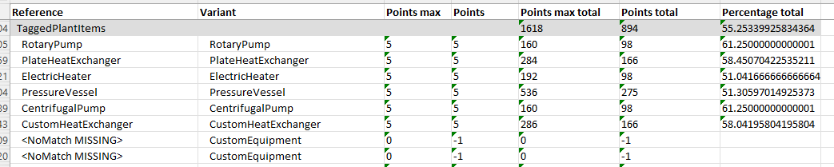
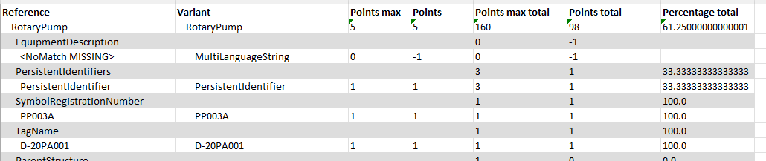
Results (here: equipment)

Slide 8
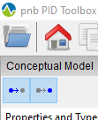
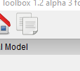
Tool Usage
1. Open both P&IDs in the same instance of the Toolbox
click here to open further P&IDs
2. Switch to window with the variant P&ID
3. Run comparison
4. Select reference P&ID in the dialog

